Slide 1

Detecting Neutrinos via active radar sensor arrays
Richard Moser,
The University of Kansas

Slide 2
UHE neutrinos
UHE ≥ 10¹⁶ eV

Slide 3
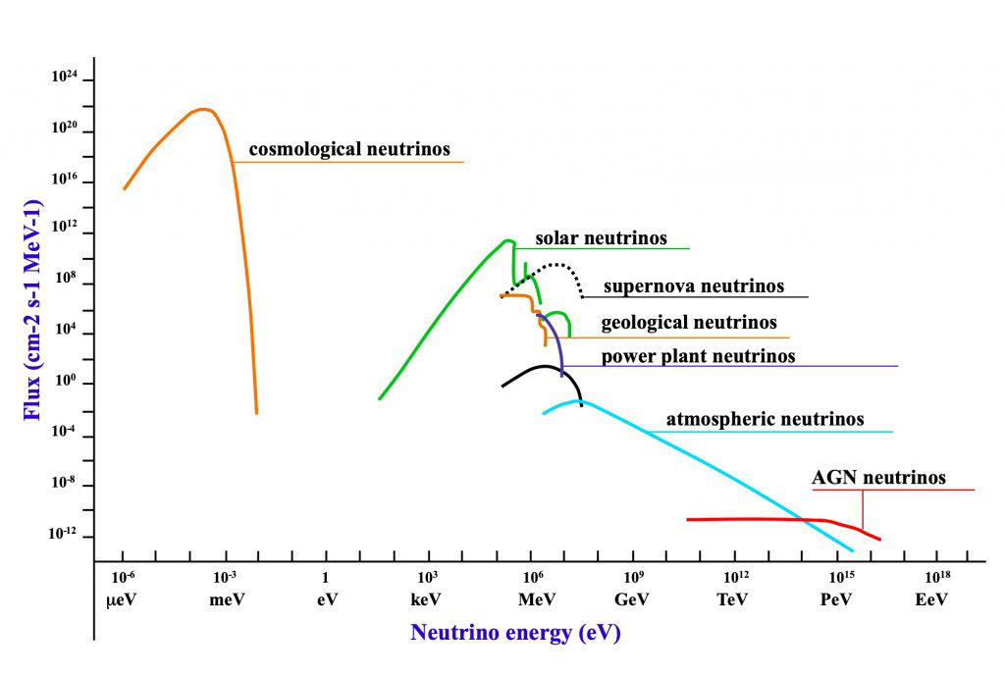
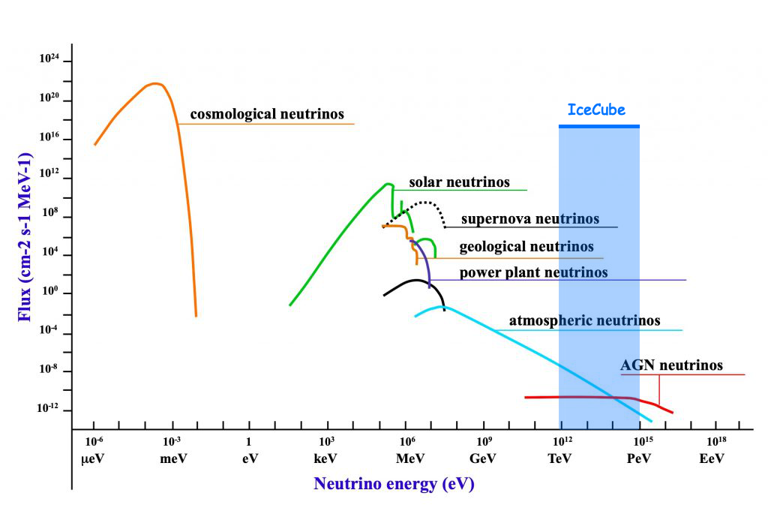
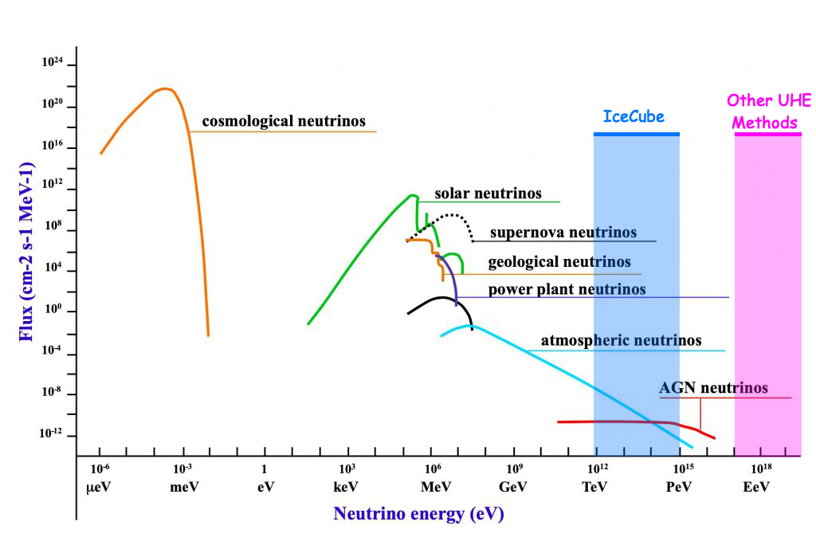
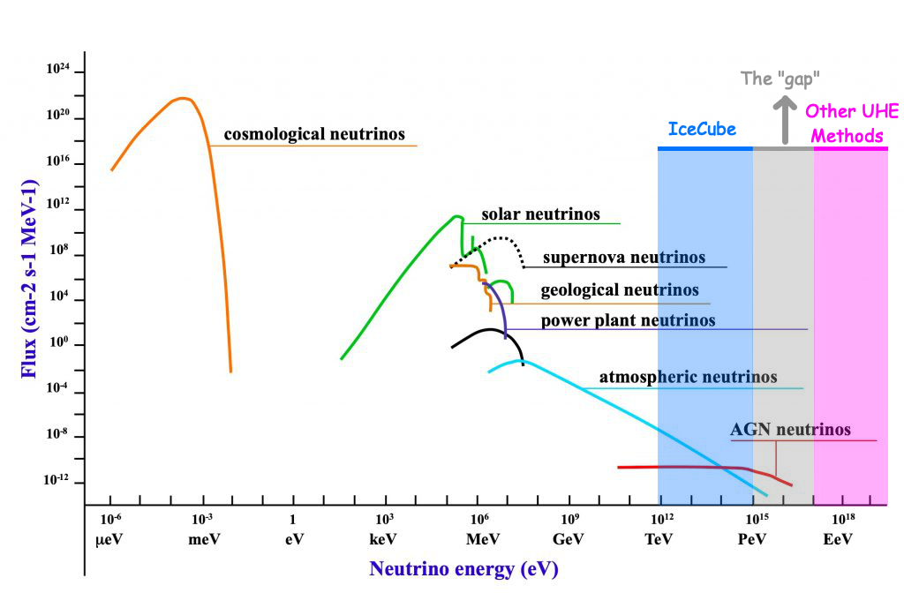
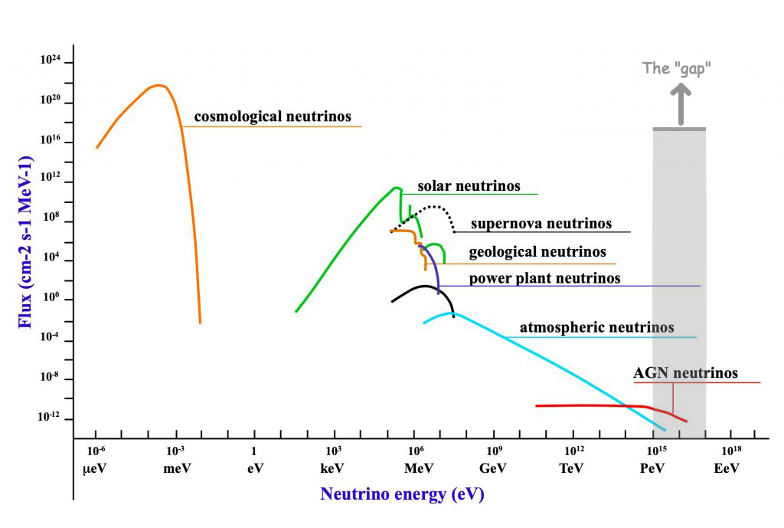
Notes:
UHE ≥ 10¹⁶ eV

Slide 4

The case for active radar emission based neutrino detection methods
“Sir, you were going 6.706e8 in a 35”

Slide 5
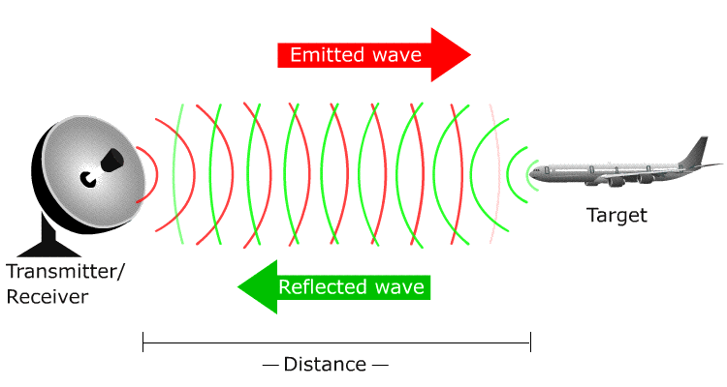
RADAR - RAdio Detection And Ranging
Requirements: Transmitter (TX), target, receiver

Slide 6
Neutrino Particle Shower Plasma
“As these shower particles traverse the interaction medium, they eject cold ionization electrons from atoms in the bulk, forming a tenuous particle-shower plasma (PSP), distinct from the energetic shower front particles responsible for ionization. For high incident particle energies (E ≥ 1 PeV, consistent with, and beyond, the experimental reach of the IceCube[1] experiment), this plasma will become dense enough to reflect incident radio-frequency (RF) radiation”

Slide 7
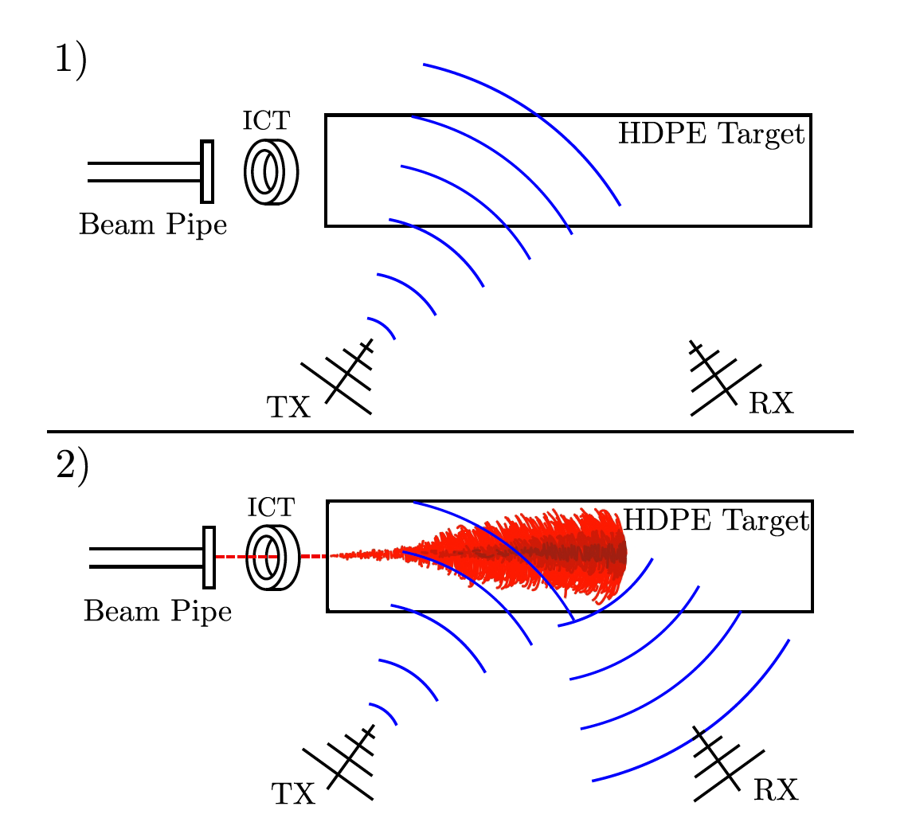
Experimental Data
Conducted at SLAC in May and October 2018
“We broadcast CW radio at a range of frequencies between 1 and 2.1 GHz and a range of amplitudes, using a signal generator, 50Wpower amplifier, and transmitting antenna (TX) toward a target of high-density polyethylene (HDPE), into which the electron beam was directed. Receiving antennas (RX) were also directed at this target to measure the radar reflection.”
Notes:
integrating current toroid (ICT) which gave a precise measurement
of the charge in each bunch

Slide 8
Advantages of active emission
RX signal strength scales with TX signal power, not just particle energy
Detection outside of the cone
The “plane” doesn’t have to hit the RX for the RX to see it
Greater detection range = lower sensor density = larger array
Better anthropogenic and background noise rejection
Received signal should closely match transmitted signal
Continuous CW pulse – from TX in shadow zone (?)
Active detection sensitivity should peak in the 10-100PeV range

Slide 10
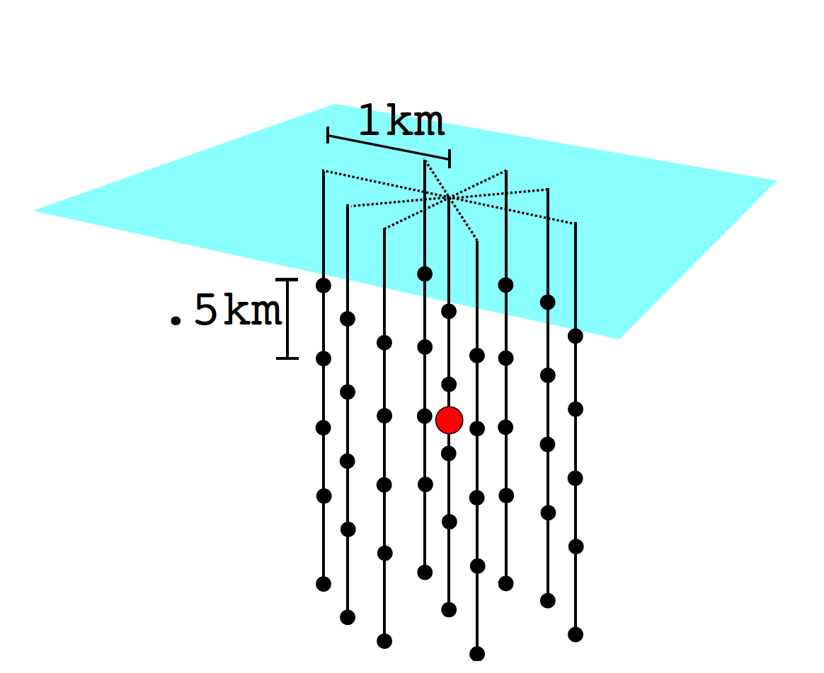
Example detector

Slide 11
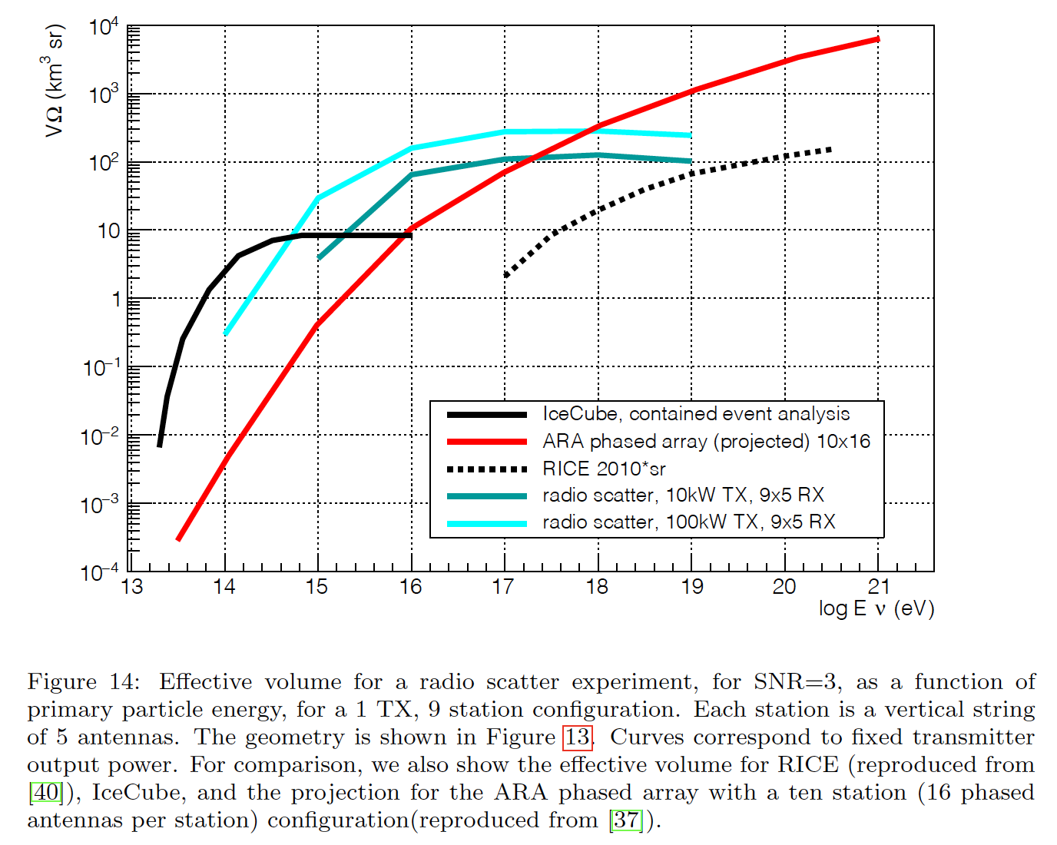
Effective array volume

Slide 12
Power
100 kW is the TX power of your average FM Radio station
Summer power: Solar (?)
A standard 100kw solar system is $130k to $200k
Snow build up on panels?
Winter Power: Wind (?)
a standard 100 kW wind turbine costs about $50k but I would *assume* several smaller modified (cold ready) turbines would be used
Maintenance?
Notes:
The Parker-Palpatine Conjunctive Power Principle: With unlimited power comes unlimited responsibility.

Slide 13
You may ask yourself: Well, how do we get there?
RadioScatter
Used to simulate incident RF Radiation from a particle shower and scattered signal
Calculates with regard to and allows testing of:
TX & RX geometries
Antenna gain
Refraction properties

Slide 14
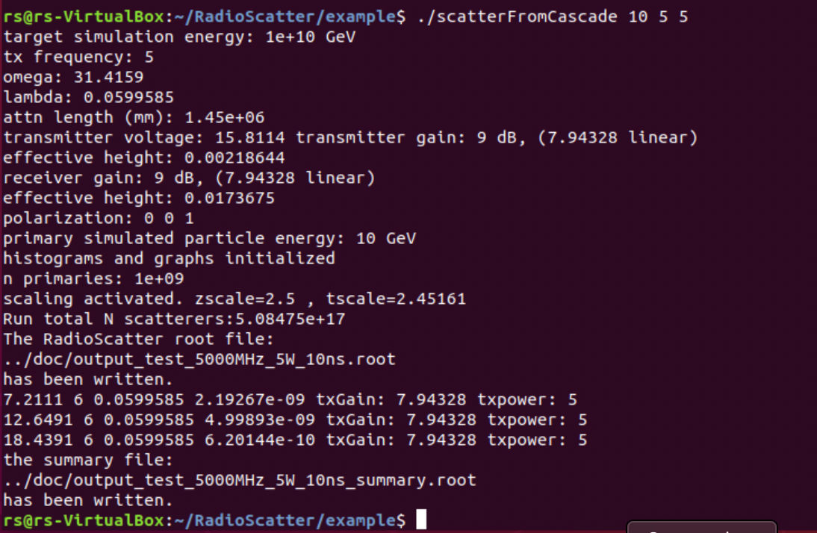
Using RadioScatter to simulate an event
./scatterFromCascade <plasma lifetime [ns]> <frequency [GHz]> <tx power [W]>

Slide 15
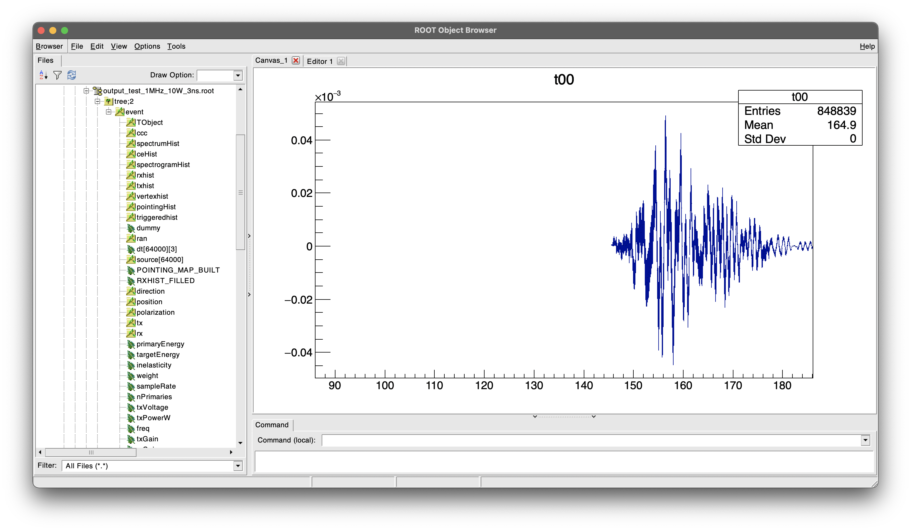
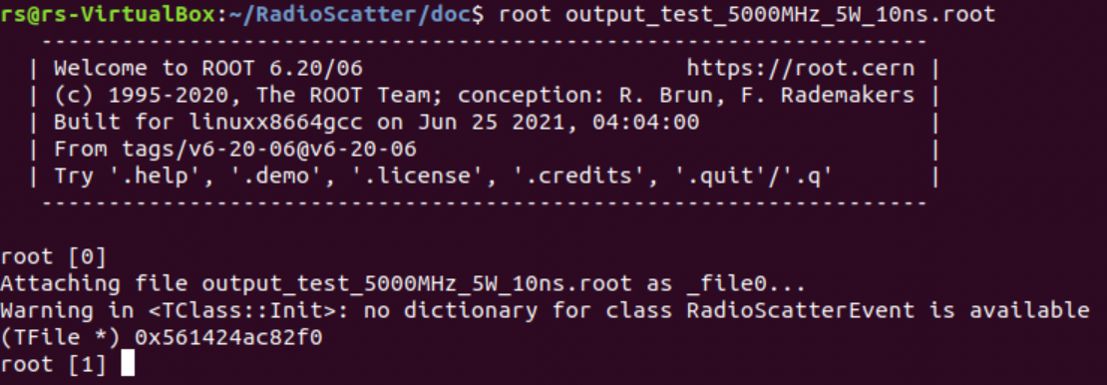
Using ROOT to look at the result

Slide 16
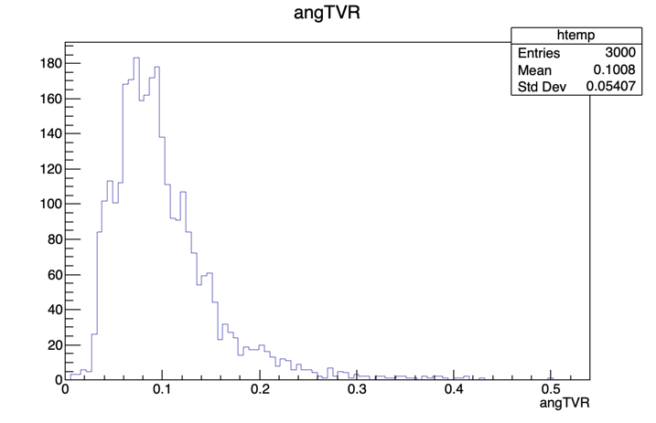
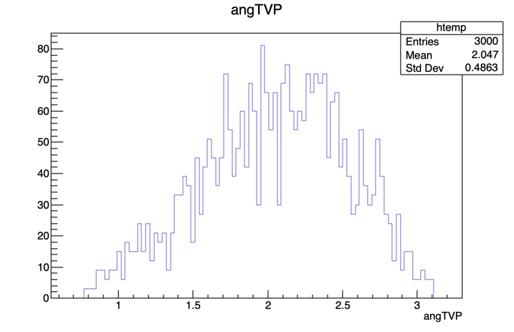
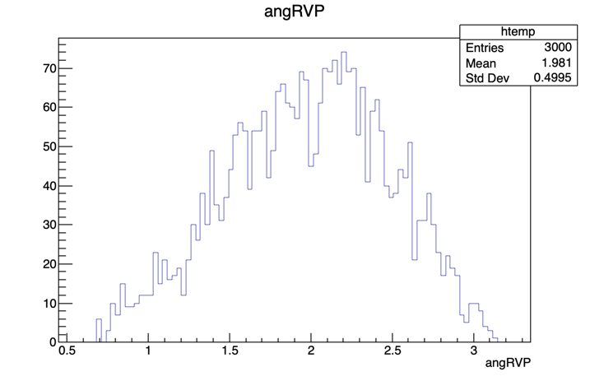

Slide 17
The path forward
GEANT4 simulations of RadioScatter data
Should work with stock RadioScatter program, I just haven’t made it that far
Dissecting the ROOT files and RadioScatter program code

Slide 18
Info, data, chart sources
Particle-level model for radar based detection of high-energy neutrino cascades
S Prohira, D Besson: 2017
https://arxiv.org/abs/1710.02883
Observation of Radar Echoes From High-Energy Particle Cascades
S. Prohira, K.D. de Vries, P. Allison, J. Beatty, D. Besson, A. Connolly, N. van Eijndhoven, C. Hast, C.-Y Kuo, U.A. Latif, T. Meures, J. Nam, A. Nozdrina, J.P. Ralston, Z. Riesen, C. Sbrocco, J. Torres, S. Wissel: 2019
https://arxiv.org/abs/1910.12830

Slide 19
Questions, Critiques, Complaints?

